Slide 1
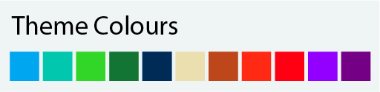
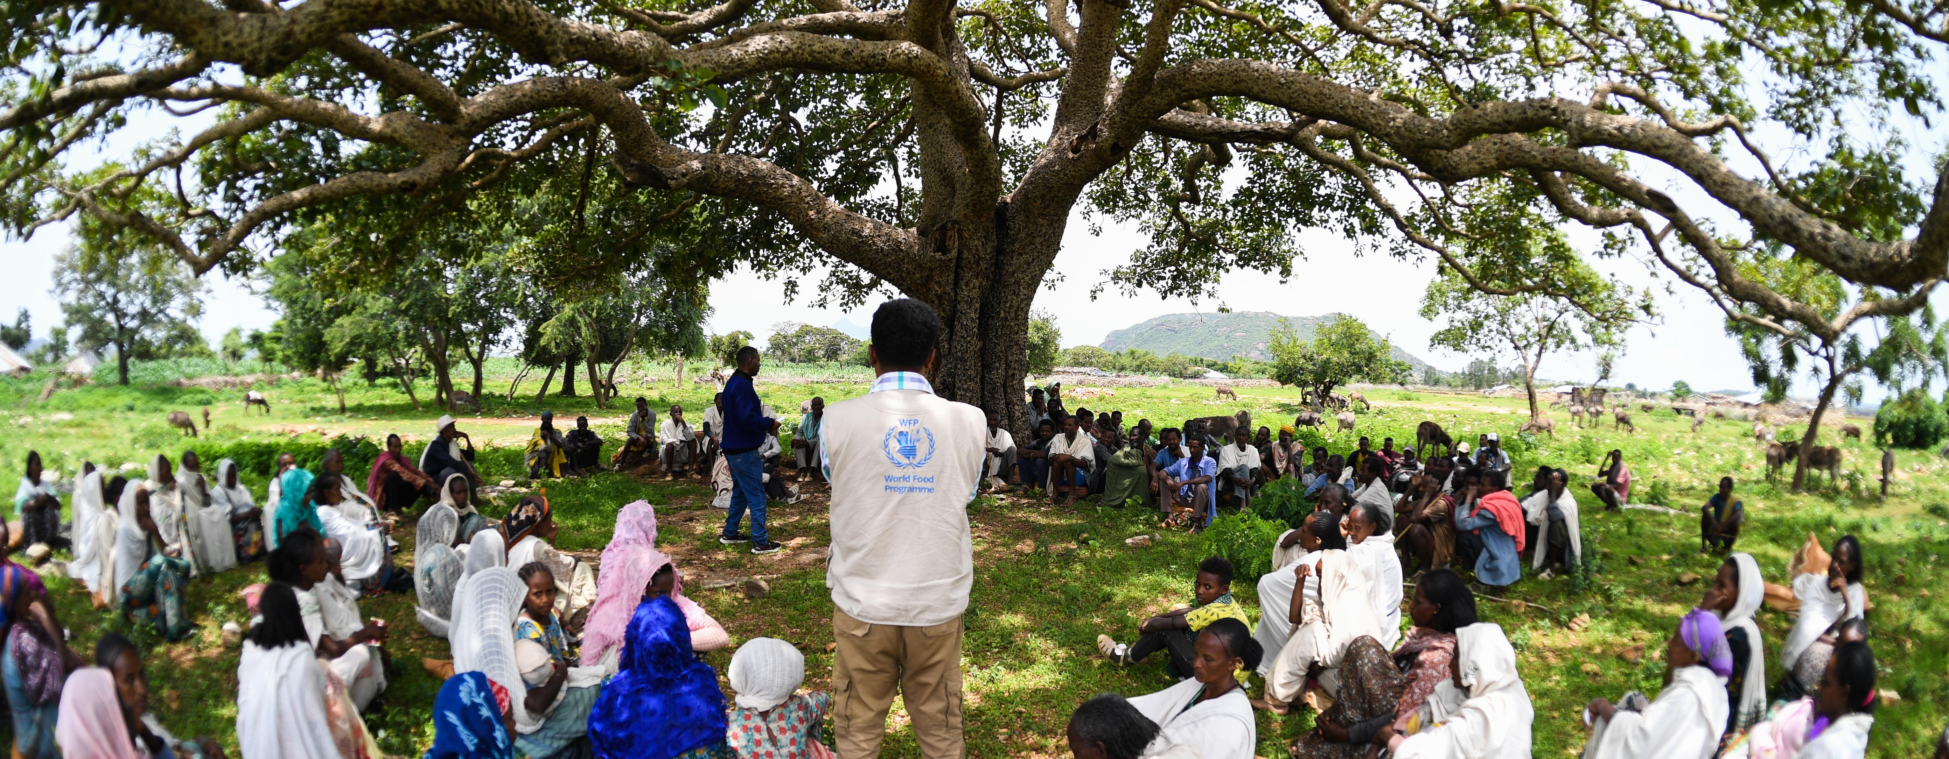

Targeting Strategy – Interview Findings Presentation to the [Country Office] Targeting Working Group
© WFP/Gabriela Vivacqua
Date

Slide 2
Note: free to change the colours to any of the WFP Corporate colours (see box to the left). Preselected photo link is in slide 1. The agenda on the right is a table.
01 | Review of Targeting Strategy Objectives
02 | Interview and Documentation Findings
03 | [Other agenda items]
04 | [Other agenda items]
05 | Next Steps and Q&A
©WFP/Rein Skullerud

Slide 3
Note: free to change the colours to any of the WFP Corporate colours (see box to the left).
Review of Targeting Strategy Objectives

Slide 4
Note: free to change the colours to any of the WFP Corporate colours (see box to the left).
CO Documentation Structure for Targeting
Country Office CSP
How WFP’s integrated programmatic offer aims to support achievement of SDG 2 in CO
[Country Office] Targeting Strategy ([CSP Duration])
How will the CO operationalize synergies across programmes through targeting, and how does it plan to improve the accuracy of targeting considering risks and potential prioritization decisions
Missing – Benchmark #4
Targeting SOP
Activity #
Detailed steps, roles, responsibilities, risk mitigation, etc.
Targeting SOP
Activity #
Detailed steps, roles, responsibilities, risk mitigation, etc.
Targeting SOP
Activity #
Detailed steps, roles, responsibilities, risk mitigation, etc.
Targeting SOP
Activity #
Detailed steps, roles, responsibilities, risk mitigation, etc.

Slide 5
Note: free to change the colours to any of the WFP Corporate colours (see box to the left).
Content of the Targeting Strategy
Background and CSP Overview
In which context are WFP programmes implemented?
Programmatic Objectives
What vulnerability framework does each programme use?
Partnerships
How do programmes from partners interact with WFP’s?
Can targeting build on synergies in vulnerability frameworks?
Coordination Mechanisms
Which coordination mechanism (internal/external) will be used to ensure decisions are in line with the strategy?
Step 1: Needs and Context Analysis (high-level)
Which data will be used to design and update the targeting?
Step 2: Targeting Design (high-level)
Which targeting method seems most appropriate (per programme/activity)?
How will we engage with communities for the design?
Step 3: Implementation (high-level)
How will we register and verify beneficiaries for our programmes?
How will we engage with communities (CFM, appeals)?
Step 4: Monitoring (high-level)
How will we monitor targeting errors and targeting risks?
Targeting Risk Management
Who are the stakeholders interested in our targeting decisions?
What are the risks around the proposed targeting approaches?
Targeting Assurance Roadmap
Which improvements will need to be integrated to our current targeting?

Slide 6
Note: free to change the colours to any of the WFP Corporate colours (see box to the left).
Sources of Information to Create the Strategy
Existing documentation
Interviews with key functions
Field visits
CSP
SOPs (Targeting, CFM, IDM)
Community Engagement Strategy
Recent Analysis/CFM Reports
AME Cost Simulation Tool
Partner Documentation
CO Risk Register
Audit Results
Management
Head of Programme
RAM (VAM, Monitoring & CFM)
SO/Activity Managers
Head of Field/Sub Offices
Cross-cutting functional experts (GPI, conflict-sensitivity, etc.)
IDM/TEC
BPU
Contextualization of strategy
Interviews with partners (if possible)
Interviews with beneficiaries (if possible)

Slide 7
Note: free to change the colours to any of the WFP Corporate colours (see box to the left).
Interview and Documentation Findings

Slide 8
Note: free to change the colours to any of the WFP Corporate colours (see box to the left).
Content of the Targeting Strategy
Background and CSP Overview
In which context are WFP programmes implemented?
Programmatic Objectives
What vulnerability framework does each programme use?
Partnerships
How do programmes from partners interact with WFP’s?
Can targeting build on synergies in vulnerability frameworks?
Coordination Mechanisms
Which coordination mechanism (internal/external) will be used to ensure decisions are in line with the strategy?
Step 1: Needs and Context Analysis (high-level)
Which data will be used to design and update the targeting?
Step 2: Targeting Design (high-level)
Which targeting method seems most appropriate (per programme)?
How will we engage with communities for the design?
Step 3: Implementation (high-level)
How will we register and verify beneficiaries for our programmes?
How will we engage with communities (CFM, appeals)?
Step 4: Monitoring (high-level)
How will we monitor targeting errors and targeting risks?
Targeting Risk Management
Who are the stakeholders interested in our targeting decisions?
What are the risks around the proposed targeting approaches?
Targeting Assurance Roadmap
Which improvements will need to be integrated to our current targeting?

Slide 9
Note: free to change the colours to any of the WFP Corporate colours (see box to the left).
Content of the Targeting Strategy
Background and CSP Overview
Summary of current status of this section:
[Add]
Programmatic Objectives
Partnerships
Coordination Mechanisms
Step 1: Needs and Context Analysis (high-level)
Key strategic considerations to include in this section :
[Add findings that could influence how the current situation is changed in the future strategy]
[Add findings that have risks for the targeting]
Step 2: Targeting Design (high-level)
Step 3: Implementation (high-level)
Step 4: Monitoring (high-level)
Targeting Risk Management
Targeting Assurance Roadmap

Slide 10
Note: free to change the colours to any of the WFP Corporate colours (see box to the left).
Content of the Targeting Strategy
Background and CSP Overview
Summary of current status of this section:
[Add]
Programmatic Objectives
Partnerships
Coordination Mechanisms
Step 1: Needs and Context Analysis (high-level)
Key strategic considerations to include in this section :
[Add findings that could influence how the current situation is changed in the future strategy]
[Add findings that have risks for the targeting]
Step 2: Targeting Design (high-level)
Step 3: Implementation (high-level)
Step 4: Monitoring (high-level)
Targeting Risk Management
Targeting Assurance Roadmap

Slide 11
Note: free to change the colours to any of the WFP Corporate colours (see box to the left).
Content of the Targeting Strategy
Background and CSP Overview
Summary of current status of this section:
[Add]
Programmatic Objectives
Partnerships
Coordination Mechanisms
Step 1: Needs and Context Analysis (high-level)
Key strategic considerations to include in this section :
[Add findings that could influence how the current situation is changed in the future strategy]
[Add findings that have risks for the targeting]
Step 2: Targeting Design (high-level)
Step 3: Implementation (high-level)
Step 4: Monitoring (high-level)
Targeting Risk Management
Targeting Assurance Roadmap

Slide 12
Note: free to change the colours to any of the WFP Corporate colours (see box to the left).
Content of the Targeting Strategy
Background and CSP Overview
Summary of current status of this section:
[Add]
Programmatic Objectives
Partnerships
Coordination Mechanisms
Step 1: Needs and Context Analysis (high-level)
Key strategic considerations to include in this section :
[Add findings that could influence how the current situation is changed in the future strategy]
[Add findings that have risks for the targeting]
Step 2: Targeting Design (high-level)
Step 3: Implementation (high-level)
Step 4: Monitoring (high-level)
Targeting Risk Management
Targeting Assurance Roadmap

Slide 13
Note: free to change the colours to any of the WFP Corporate colours (see box to the left).
Content of the Targeting Strategy
Background and CSP Overview
Summary of current status of this section:
[Add]
Programmatic Objectives
Partnerships
Coordination Mechanisms
Step 1: Needs and Context Analysis (high-level)
Key strategic considerations to include in this section :
[Add findings that could influence how the current situation is changed in the future strategy]
[Add findings that have risks for the targeting]
Step 2: Targeting Design (high-level)
Step 3: Implementation (high-level)
Step 4: Monitoring (high-level)
Targeting Risk Management
Targeting Assurance Roadmap

Slide 14
Note: free to change the colours to any of the WFP Corporate colours (see box to the left).
Content of the Targeting Strategy
Background and CSP Overview
Summary of current status of this section:
[Add]
Programmatic Objectives
Partnerships
Coordination Mechanisms
Step 1: Needs and Context Analysis (high-level)
Key strategic considerations to include in this section :
[Add findings that could influence how the current situation is changed in the future strategy]
[Add findings that have risks for the targeting]
Step 2: Targeting Design (high-level)
Step 3: Implementation (high-level)
Step 4: Monitoring (high-level)
Targeting Risk Management
Targeting Assurance Roadmap

Slide 15
Note: free to change the colours to any of the WFP Corporate colours (see box to the left).
Content of the Targeting Strategy
Background and CSP Overview
Summary of current status of this section:
[Add]
Programmatic Objectives
Partnerships
Coordination Mechanisms
Step 1: Needs and Context Analysis (high-level)
Key strategic considerations to include in this section :
[Add findings that could influence how the current situation is changed in the future strategy]
[Add findings that have risks for the targeting]
Step 2: Targeting Design (high-level)
Step 3: Implementation (high-level)
Step 4: Monitoring (high-level)
Targeting Risk Management
Targeting Assurance Roadmap

Slide 16
Note: free to change the colours to any of the WFP Corporate colours (see box to the left).
Content of the Targeting Strategy
Background and CSP Overview
Summary of current status of this section:
[Add]
Programmatic Objectives
Partnerships
Coordination Mechanisms
Step 1: Needs and Context Analysis (high-level)
Key strategic considerations to include in this section :
[Add findings that could influence how the current situation is changed in the future strategy]
[Add findings that have risks for the targeting]
Step 2: Targeting Design (high-level)
Step 3: Implementation (high-level)
Step 4: Monitoring (high-level)
Targeting Risk Management
Targeting Assurance Roadmap

Slide 17
Note: free to change the colours to any of the WFP Corporate colours (see box to the left).
Content of the Targeting Strategy
Background and CSP Overview
Summary of current status of this section:
[Add]
Programmatic Objectives
Partnerships
Coordination Mechanisms
Step 1: Needs and Context Analysis (high-level)
Key strategic considerations to include in this section :
[Add findings that could influence how the current situation is changed in the future strategy]
[Add findings that have risks for the targeting]
Step 2: Targeting Design (high-level)
Step 3: Implementation (high-level)
Step 4: Monitoring (high-level)
Targeting Risk Management
Targeting Assurance Roadmap

Slide 18
Note: free to change the colours to any of the WFP Corporate colours (see box to the left).
Content of the Targeting Strategy
Background and CSP Overview
Already submitted to GlobalHQ, see next slide. Changes to be defined based on the strategy.
Programmatic Objectives
Partnerships
Coordination Mechanisms
Step 1: Needs and Context Analysis (high-level)
Step 2: Targeting Design (high-level)
Step 3: Implementation (high-level)
Step 4: Monitoring (high-level)
Targeting Risk Management
Targeting Assurance Roadmap

Slide 19
Example to be modified
Targeting Assurance Roadmap | [Country Office]
 |  | Status [Date] | Priority | Q1 2026 |  |  | Q2 2026 |  |  | Q3 2026 |  |  | Q4 2026 |  |  | Functions involved
 |  |  |  | JAN | FEB | MAR | APR | MAY | JUN | JUL | AUG | SEP | OCT | NOV | DEC
Accountability and Risk Management
14 | [Next step] |  |  |  |  |  |  |  |  |  |  |  |  |  |  | All
15 | [Next step] |  |  |  |  |  |  |  |  |  |  |  |  |  |  | RAM, Prog., CP
13 | [Next step] |  |  |  |  |  |  |  |  |  |  |  |  |  |  | RAM, Risk
Coordination and Strategy
2 | [Next step] |  |  |  |  |  |  |  |  |  |  |  |  |  |  | RAM, Prog.
16 | [Next step] |  |  |  |  |  |  |  |  |  |  |  |  |  |  | RAM, Prog.
11-12 | [Next step] |  |  |  |  |  |  |  |  |  |  |  |  |  |  | RAM, BPO
4 | [Next step] |  |  |  |  |  |  |  |  |  |  |  |  |  |  | All
Standard Operating Procedures
1 | [Next step] |  |  |  |  |  |  |  |  |  |  |  |  |  |  | RAM
6 | [Next step] |  |  |  |  |  |  |  |  |  |  |  |  |  |  | RAM, IDM, TEC
3 | [Next step] |  |  |  |  |  |  |  |  |  |  |  |  |  |  | RAM, COM, Prog.
7 | [Next step] |  |  |  |  |  |  |  |  |  |  |  |  |  |  | Partnerships
9 | [Next step] |  |  |  |  |  |  |  |  |  |  |  |  |  |  | RAM
5 | [Next step] |  |  |  |  |  |  |  |  |  |  |  |  |  |  | RAM, Prog.
10 | [Next step] |  |  |  |  |  |  |  |  |  |  |  |  |  |  | RAM, CFM
8 | [Next step] |  |  |  |  |  |  |  |  |  |  |  |  |  |  | RAM, COM, CFM
11-12 | [Next step] |  |  |  |  |  |  |  |  |  |  |  |  |  |  | RAM, CP man.
Benchmark #
Next step

Slide 20
Note: free to change the colours to any of the WFP Corporate colours (see box to the left).
Next Steps and Q&A

Slide 21
Next Steps
 | Month |  |  |  |  |  |  |  |  |  |  |  |  |  |  |  |  |  |  |  | Month
 | Day | Day | Day | Day | Day | Day | Day | Day | Day | Day | Day | Day | Day | Day | Day | Day | Day | Day | Day | Day | Day | Day | Day | Day | Day
Targeting Strategy
1. Desk review of documentation
2. Interview management on objectives
3. Interview SO and activity managers
4. Field visits
5. Interview cross-cutting experts
6. Presentation of priorities/gaps to TWG
7. Draft integrated framework for targeting
8. Presentation of framework to TWG
9. Consultations with external stakeholders
10. Drafting of the targeting strategy
11. First review by TWG
12. Review of the targeting strategy
13. Presentation of open questions to TWG
14. Review of the targeting strategy
15. Endorsement and dissemination

Slide 22
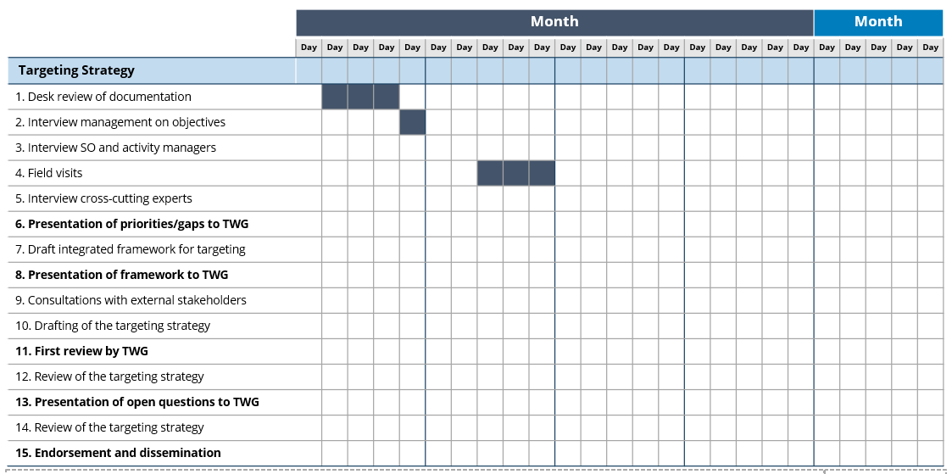
How to update the next steps
→ Identify someone who will keep an eye on the progress and follow-ups
→ 2-3 months might be needed to go through all the steps
Add months, days and color the appropriate boxes to create a Gantt Chart
Steps can be adjusted to the context of the CO

Slide 23
Note: free to change the colours to any of the WFP Corporate colours (see box to the left).
Thank you!

